Slide 1
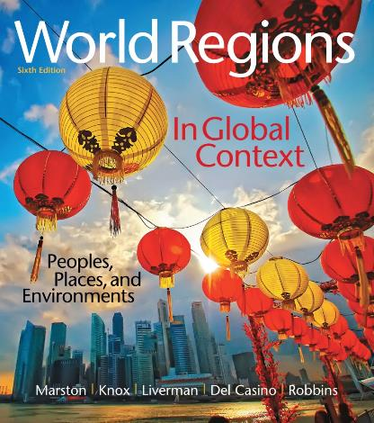
World Regions in Global Context:
Peoples, Places, and Environments
6th Edition
World Regions in
Global Context
Lectures by:
Christa Ann Smith

Slide 2
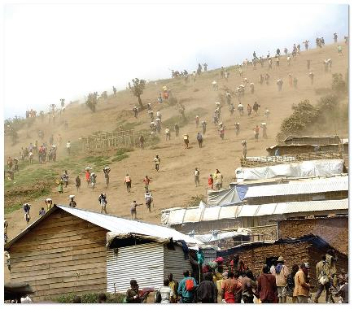
Thinking Like a Geographer
Geography
global relationships
human/environment interactions
Physical geography
climate, landforms, ecology
Human geography
spatial organization
Environmental geography
connects human/physical geography

Slide 3
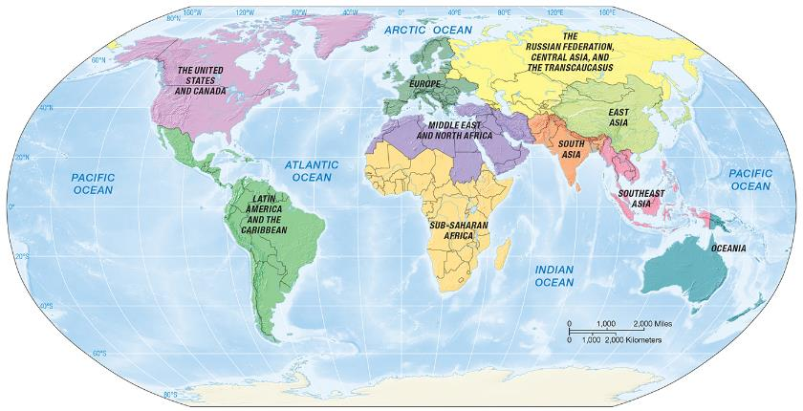
Thinking Like a Geographer, (cont)
World regional geography
examines geographical processes
explains why and how patterns emerge

Slide 4
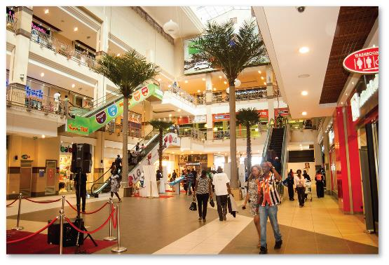
Place and the Making of Regions
Regions
aggregation of places
connections between places over time
Regionalism
strong feeling of collective identity

Slide 5
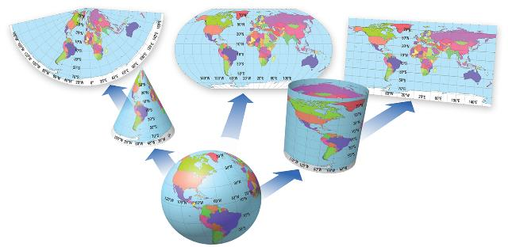
Maps and Mapping
Map
visual representation of Earth’s surface
important geographic tool
Grid system
latitude
longitude
projections

Slide 6
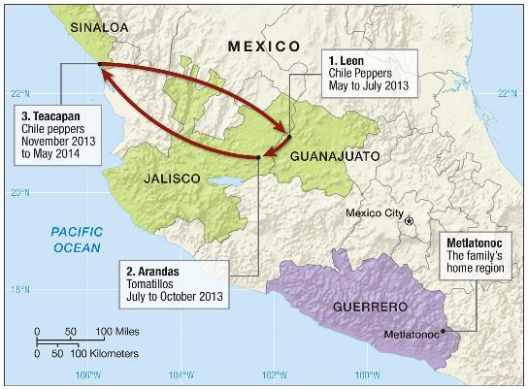
Globalization and Regionalization
Globalization
system of elements linked together
Regionalization
why new regions emerge

Slide 7
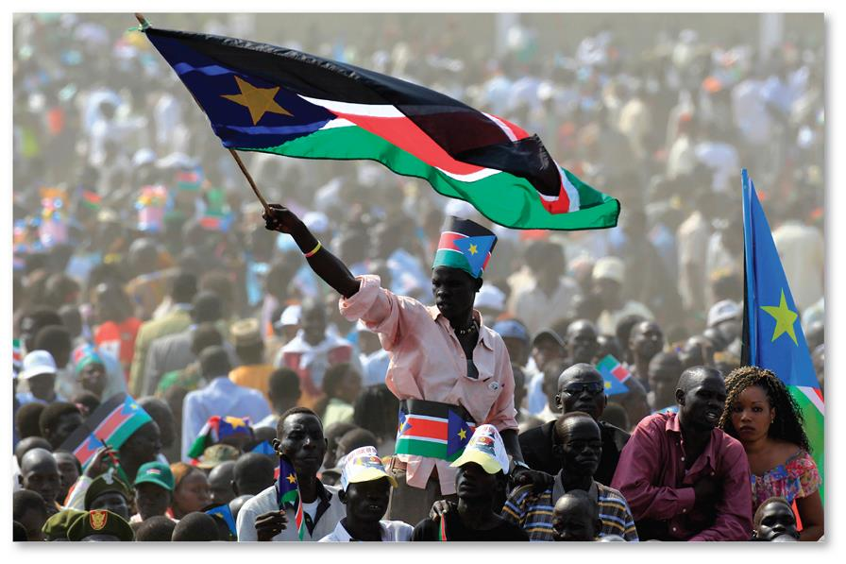
A World of Regions

Slide 8
Organizing and Exploring the World’s Regions
Framework for studying regions
Environment, Society, and Sustainability
History, Economy, and Territory
Culture and Populations
Future Geographies

Slide 9
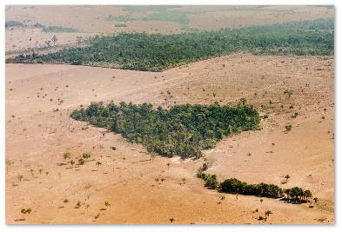
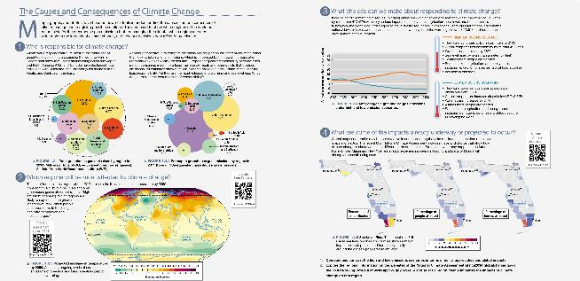
Environment, Society, and Sustainability
Environment: everything that
surrounds us
very little untouched nature
Human impact on Earth’s system
now live in Anthropocene
human activity dominates
earth system

Slide 10
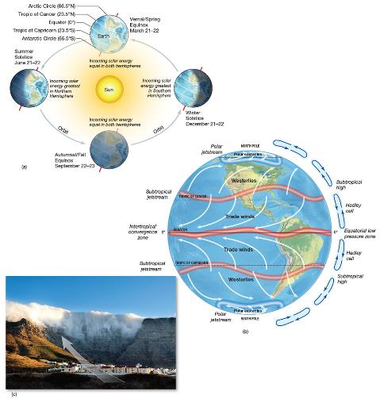
Climate and Climate Change
Weather
current precipitation/temperatures
Climate
average weather at a location
over time
Climate systems
solar interaction with atmosphere, hydrosphere, lithosphere, biosphere.
Atmospheric circulation
air and ocean currents
transports heat and moisture from one place to another

Slide 11
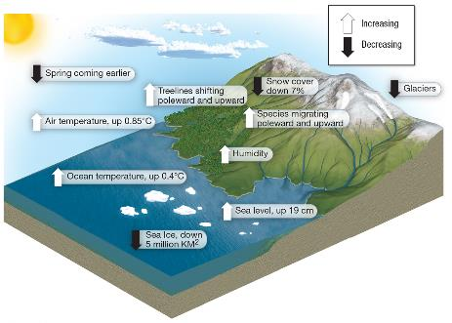
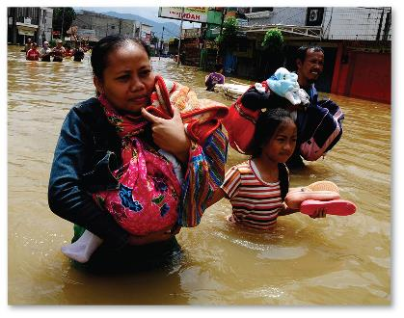
Ecological Landscapes (cont.)
Greenhouse gases
Global warming
heat trapped in atmosphere
climate extremes

Slide 12
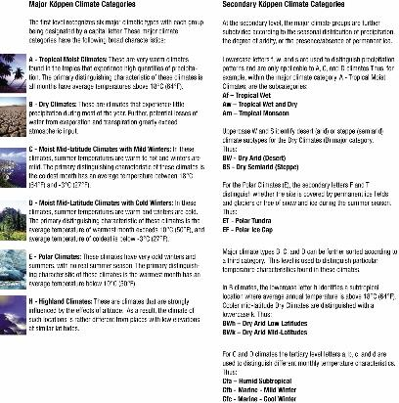
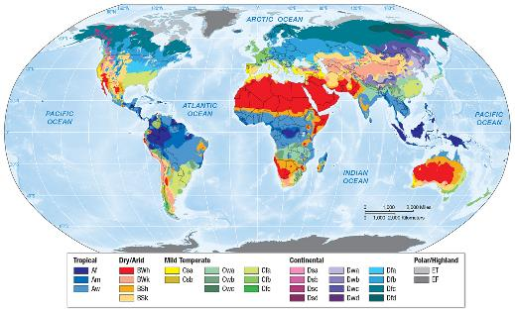
Climate and Climate Change, (cont)
Köppen climate classification

Slide 13
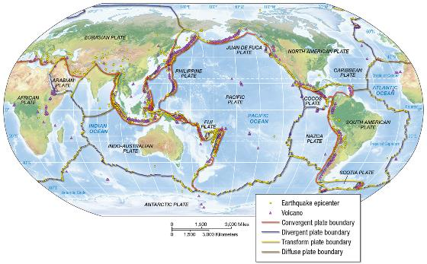
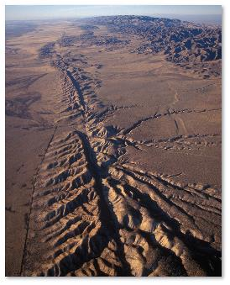
Furs
Geomorphology
physical processes that shape landforms
Plate tectonics
convergent
divergent
transform

Slide 14
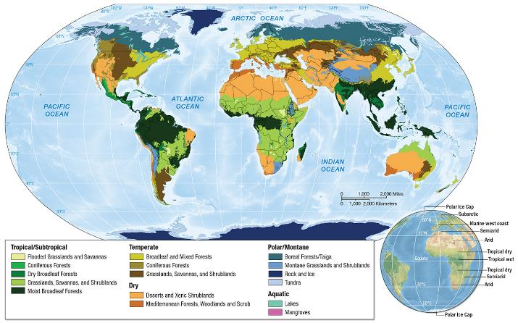
Ecology, Land, and Environmental Management
Biomes
large regions of similar climates/physical conditions

Slide 15
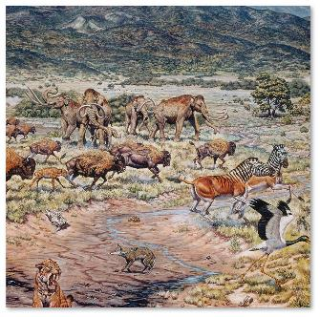
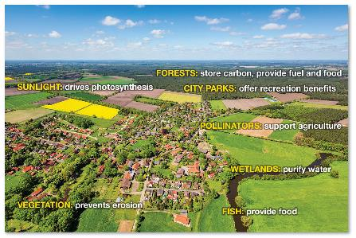
Ecology, Land, and Environmental Management, (cont)
Biodiversity
species variation
Ecosystem services
Rewilding
reintroduction of wild species
Invasive species

Slide 16
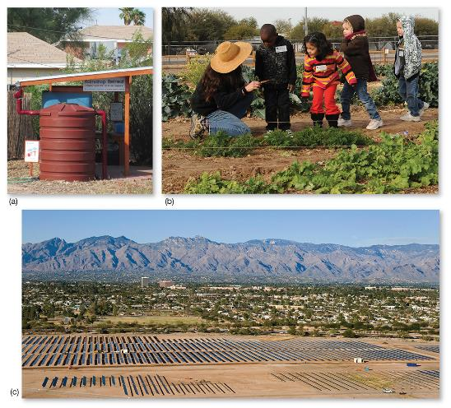
Sustainability and the Future
Sustainability
triple bottom line: serving profit, people, and the planet
growing local food
water conservation
recycled compost

Slide 17
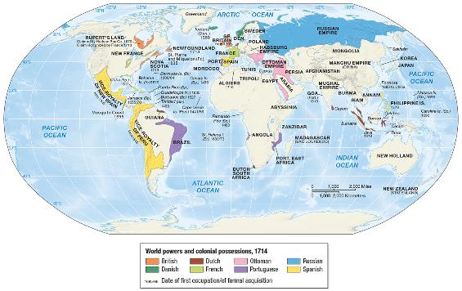
History, Economy, and Territory
Colonialism
regions and societies dominated by external society
First wave
European investment in port cities
plantation economies

Slide 18
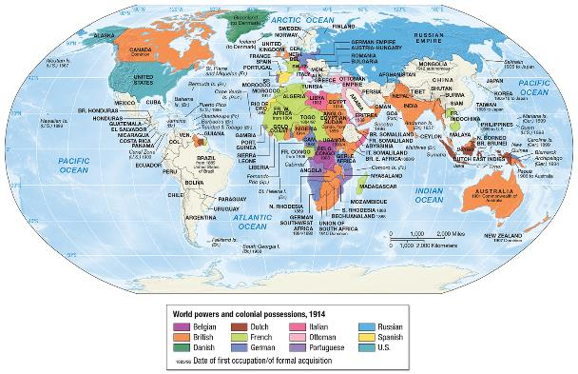
History, Economy, and Territory, (cont)
Second Wave
Africa/Asia/Australia
imperialism
Industrial Revolution
capitalism

Slide 19
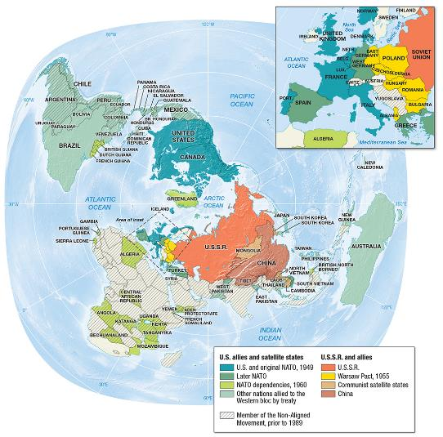
History, Economy, and Territory, (cont)
Decolonization
Communism
Cold War

Slide 20
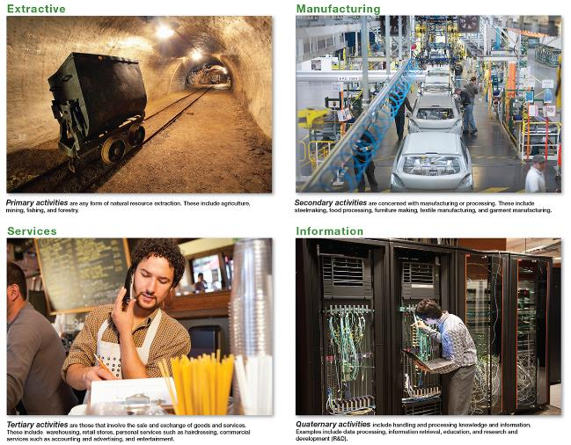
Economy, Accumulation, and the Production of Inequality
Primary
Secondary
Tertiary
Quaternary
MNCs

Slide 21
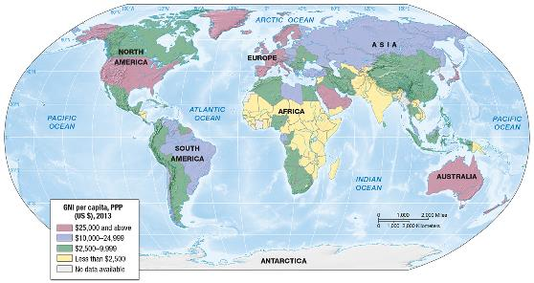
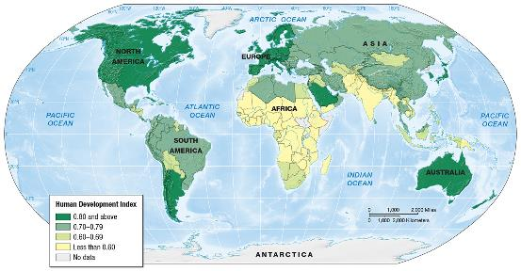
Economy, Accumulation, and the Production of Inequality, (cont)
Gross Domestic Product (GDP)
Gross National Income (GNI)
Purchasing Power Parity (PPP) per capita
Corrective measure
Global
north/global south
HDI

Slide 22
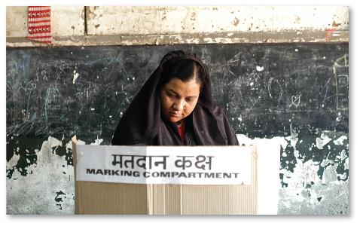
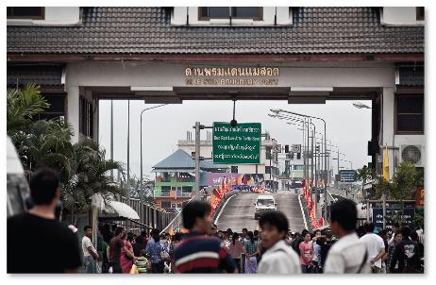
Territory and Politics
Sovereign state vs nation
Nation-state
Failed state
Supranational organizations
NGOs

Slide 23
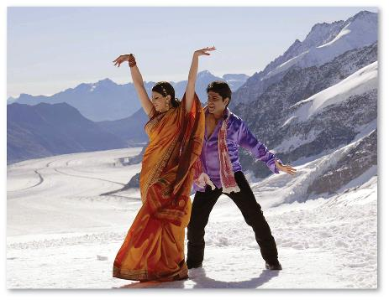
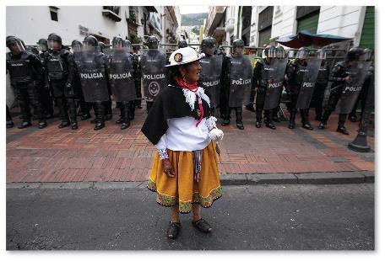
Culture and Populations
Culture
shared set of meanings and practices
Demographics
population densities
population movements

Slide 24
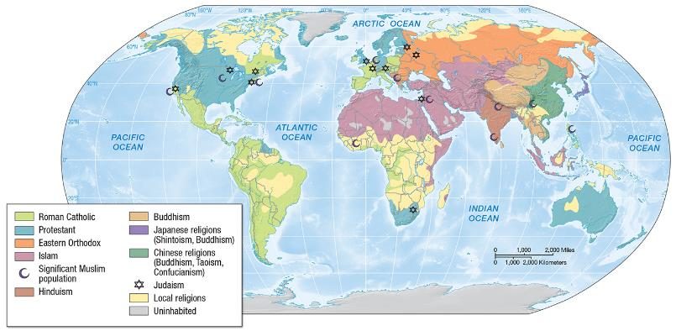
Culture, Religion, and Language
Geographies of religion
diffusion
global distribution
spread of religious fundamentalism

Slide 25
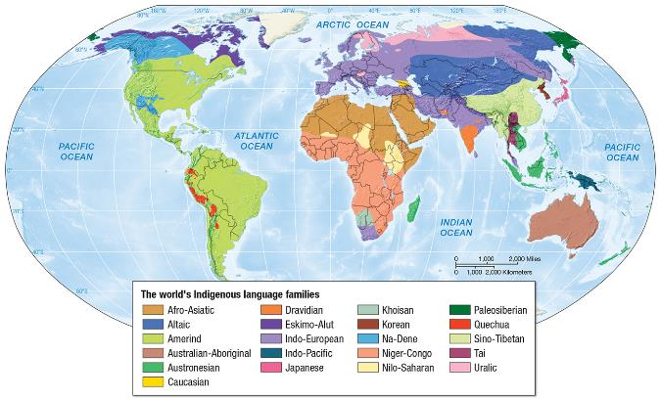
Culture, Religion and Language, (cont)
Geographies of language
global distribution
dialects
lingua franca

Slide 26
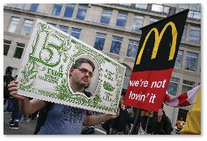

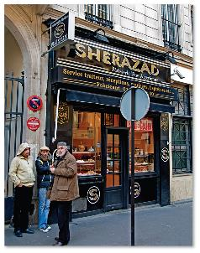
Cultural Practices, Social Differences, and Identity
Ethnicity
community identity
Race
problematic
Gender
socially learned differences between
men/women
Class
based on wealth and access to resources
Sexuality

Slide 27
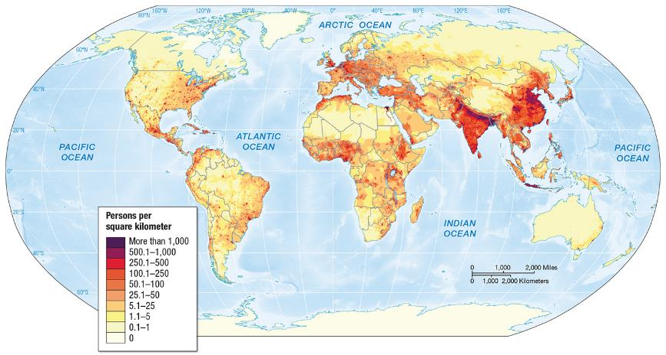
Demography and Urbanization
Uneven distribution
7 billion global population

Slide 28
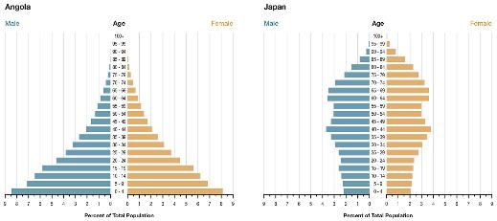
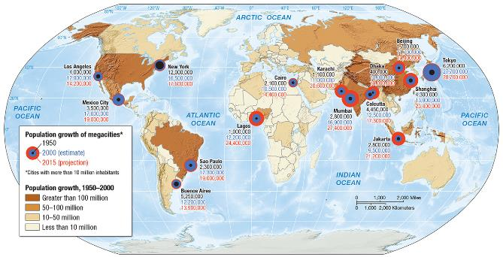
Demography and Urbanization, (cont)
Megacities
rural to urban migrations
birth rates
death rates
population pyramids

Slide 29
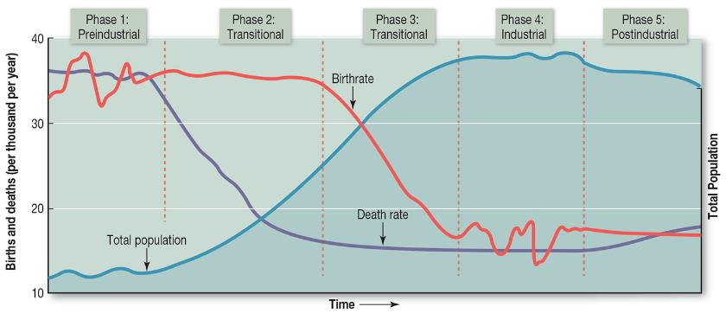
Modeling Demographic Change
Demographic transition
predicts patterns of change over time
women’s status and fertility
Population pyramids

Slide 30
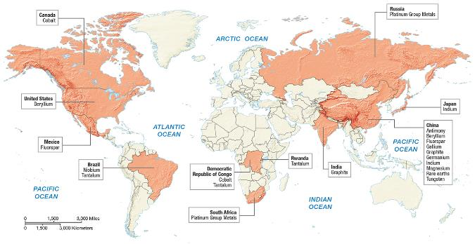
Future Geographies
Population Boom or Bust?
regional decreases
regional increases
Emerging Resource Regions
globalization of resources
new resource regions

Slide 31
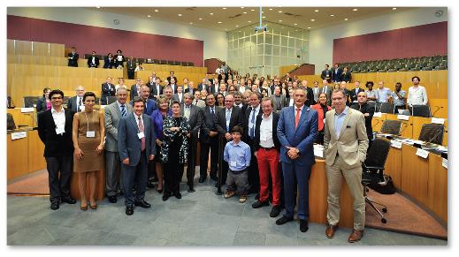
Economic Globalization and Challenges to Regional Governance
Supranational
organizations
NAFTA
EU
WTO
Goal of creating
global trading areas
states/cities increasingly making connections with supranational organizations

Slide 32
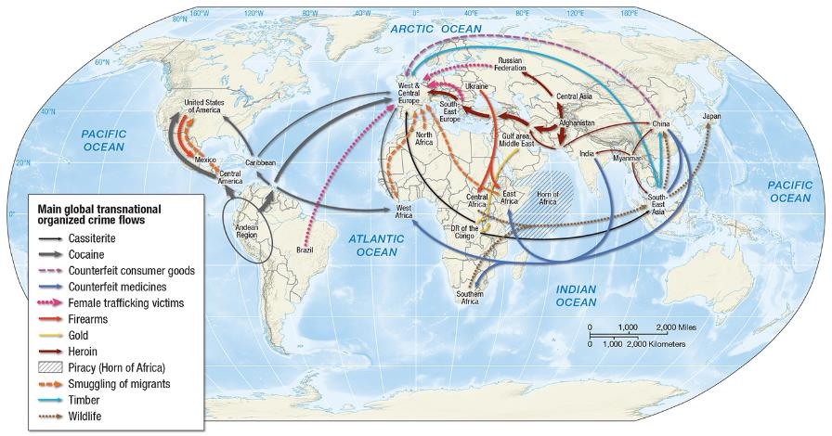
New Regions of Insecurity and Crime
Internationalization of crime

Slide 33
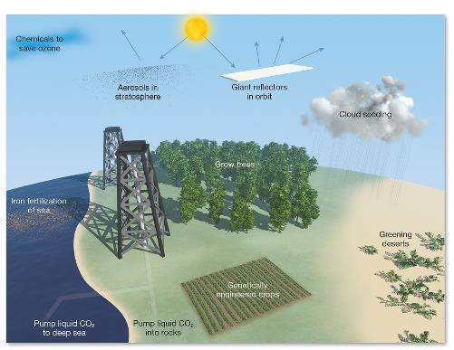
Future Environmental Threats and Global Sustainability
Multiple threats to the environment
loss of biodiversity
water and air pollution
greenhouse gas emissions
Geoengineering
block incoming sunlight
carbon storage

Slide 34
End of Chapter 1

